Slide 1



Srishyla Educational Trust(S) Bheemasamudra® GM INSTITUTE OF TECHNOLOGY, DAVANGERE Approved by AICTE | Affiliated to VTU Belagavi | Recognized by Govt. of Karnataka
Department of Information Science & Engineering
PRESENTATION ON
‘’ Smart assistive stick ’’
Project Coordinator & Guide :
Mr. Imran Khan
B.E, MTech (Ph.D.)
Assistant Professor, ISE
Head of the Department:
Dr. Neelambike S
B.E, MTech , Ph.D
Associate Professor & Head, ISE
Presented By:
Ismail Zabiulla – 4GM21IS019
Madiha Anjum – 4GM21IS028
Shankramma M L – 4GM21IS041
Yerramsetty Nirmal Sai Teja – 4GM21IS063

Slide 2


Srishyla Educational Trust (R), Bheemasamudra GM INSTITUTE OF TECHNOLOGY, DAVANAGERE (Affiliated to VTU, Belagavi, Approved by AICTE -New Delhi & Govt. of Karnataka) Department Of Information Science and Engineering
VISION
To evolve as an Excellent Technological Education Centre of Information Science and Engineering to create competitive professional engineers for the advancement of society.
MISSION
M1: To provide Application Specific Training & Practical Experience for developing Quality engineers in Information Science & Engineering. M2: To Inculcate Creative Skills in students to become Competent in the field of Information Science & Engineering. M3: To Inculcate Professional, Social and Ethical values in students to perform better in diverse environment.

Slide 3

Program Educational Objectives
PEO1: To develop graduates who are proficient to solve wide range of computing related problems.
PEO2: To prepare graduates who have the necessary skills required for Higher Education & Entrepreneurship.
PEO3: To prepare graduates who have the ability to engage in Lifelong Learning.
Program Specific Outcomes
Graduates of Information Science & Engineering are:
Capable to design, develop & test the IT Solutions in real time.
Competent to apply knowledge to manage & monitor IT resources

Slide 4







BRIEF ON PHASE 1
01
Introduction
02
Existing Technology
03
Problem statement
04
05
06
Methodology
Objectives
Scope
07
08
09
Requirements
Project Schedule
Summary

Slide 5
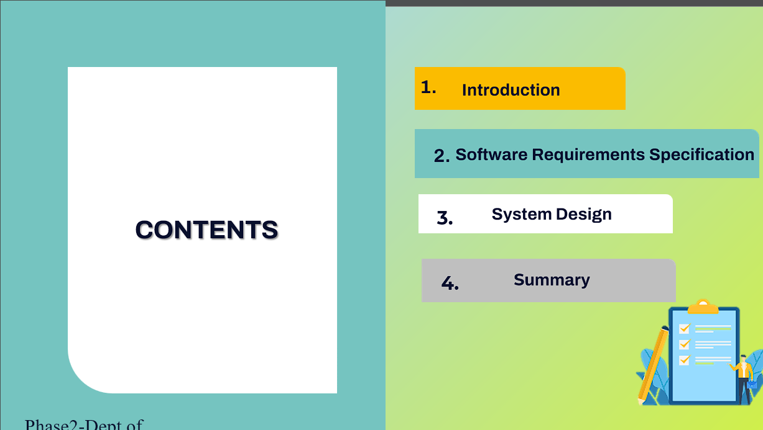

Slide 6


Slide 7
INTRODUCTION
People around the world suffer from blindness or visual impairments, which significantly affect their ability to navigate and live independently.
To address this, our project introduces an innovative solution that combines modern technologies to assist visually impaired individuals in navigating their surroundings safely.

Slide 8

EXISTING TECHNOLOGY

Slide 9
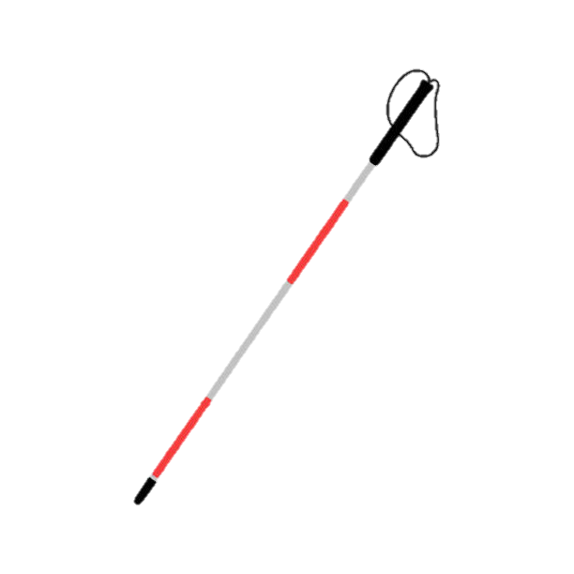
TRADITIONAL WHITE CANE
Simple, affordable tool for mobility and obstacle detection.
Widely used by visually impaired individuals for decades.
Limited in detecting obstacles above ground level.
No real-time feedback or advanced features like obstacle alert.

Slide 10
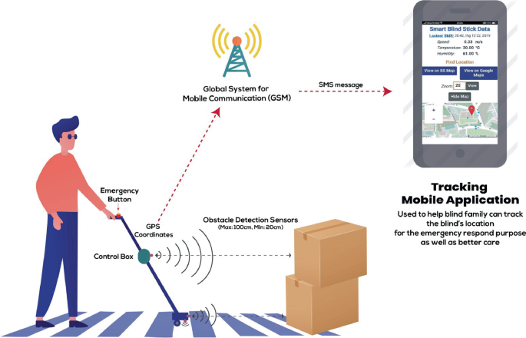
SMARTPHONE INTEGRATION
Allows integration with GPS and apps for navigation assistance.
Can offer real-time data through mobile applications.
Dependent on the user’s ability to handle smartphones.
Limited in areas with poor signal or GPS reception.

Slide 11
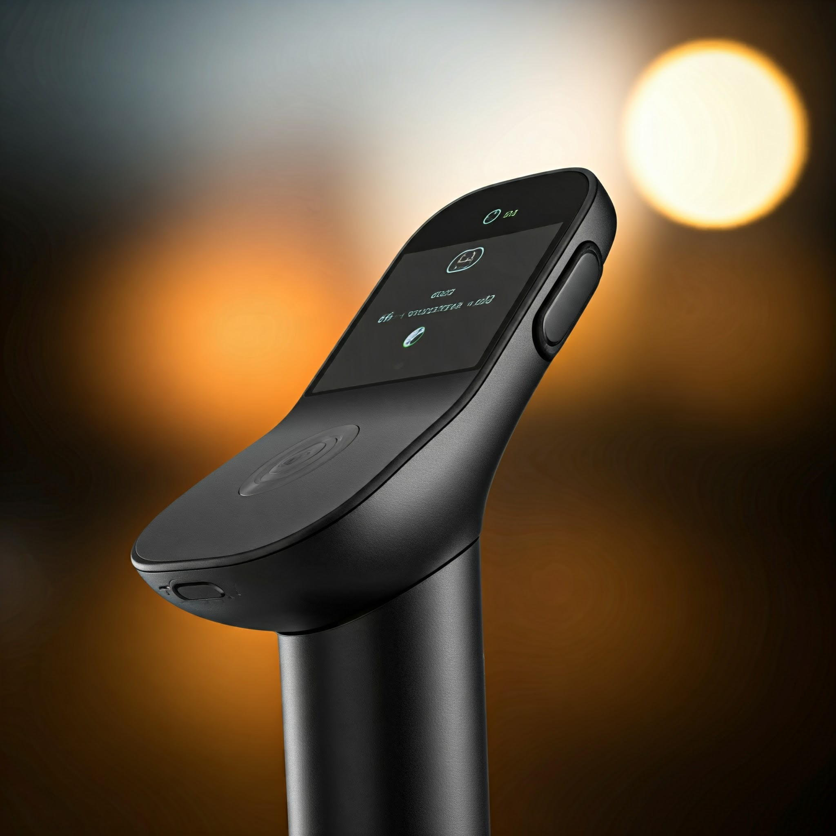
VOICE RECOGNITION &
SPEECH OUTPUT
Provides voice commands for user convenience.
Offers feedback via speech to alert users of obstacles or directions.
Voice recognition may fail in noisy environments.
Speech output could be slow or misinterpreted in real-time scenarios.

Slide 12



Slide 13

PROBLEM STATEMENT
SMART ASSISITIVE STICK
“The project addresses the challenges faced by visually impaired individuals in navigating their surroundings. Traditional white canes, while widely used, have limitations such as short-range detection and inability to identify obstacles like water, stairs, or barriers at various heights”

Slide 14
SOLUTION
The proposed solution is to develop a smart cane equipped with advanced sensors, such as ultrasonic, depth sensors, to detect obstacles at various distances and heights.
The smart cane will provide feedback to the user through vibrations or sounds, making it easy to understand and react to potential hazards.

Slide 15
OBJECTIVES
Detect obstacles in all directions using an ultrasonic sensor with servo motor movement.
Provide voice alerts to guide visually impaired users safely.
Enhance user safety by sending location-based SMS alerts to guardians.
Improve navigation independence for visually impaired individuals.

Slide 16
ADVANTAGES
01
Provides real-time obstacle detection for safe navigation.
Delivers voice alerts for immediate awareness of surroundings.
Sends SMS alerts with location, ensuring enhanced user safety.
Offers improved mobility and independence for visually impaired individuals.
Combines cost-effective technology with robust safety features.
02
03
04
05

Slide 17



Slide 18

FUNCTIONAL REQUIREMENTS
Obstacle Detection in All Directions
Voice Alerts for Guidance
Location-Based SMS Alerts for User Safety
Improved Navigation for Independence

Slide 19




NON-FUNCTIONAL REQUIREMENTS

Slide 20
TEST ID | COMPONENT | TEST SCENARIO | INPUT | EXPECTED OUTPUT | PASS/FAIL
UT-01 | Ultrasonic Sensor | Detect obstacle within threshold distance | Object at 20cm distance | Distance detected as 20cm | PASS
UT-02 | GSM Module (SMS) | Send location-based SMS alert | Emergency trigger event | SMS sent to guardian with location details | PASS
UT-03 | GPS Module | Fetch current location coordinates. | GPS module activated | Latitude and Longitude values returned | PASS
UT-04 | Voice Alert System | Generate alert for detected obstacle | Obstacle detected at 20cm ahead | Voice alert: "Obstacle ahead, 20cm meter away" | PASS
UNIT TESTING

Slide 21
TEST ID | COMPONENT | TEST SCENARIO | INPUT | EXPECTED OUTPUT | PASS/FAIL
IT-01 | Ultrasonic Sensor + Servo Motor | Obstacle detection in multiple directions | Object placed at varying angles | Obstacle detected and direction identified | PASS
IT-02 | Sensor + Voice Alert System | Generate voice alert after obstacle detection | Obstacle at 20cm distance | Voice alert: "Obstacle detected, 20cm away" | PASS
IT-03 | GSM Module + GPS Module | Send SMS with location | Emergency event triggered | SMS sent with accurate location | PASS
IT-04 | All Modules | Test complete object detection and alerting | Obstacle at 20cm, trigger event | Alerts generated, SMS sent with location | PASS
INTEGRATION TESTING

Slide 22
TEST ID | COMPONENT | TEST SCENARIO | INPUT | EXPECTED OUTPUT | PASS/FAIL
ST-01 | Obstacle Detection and Alerts | Detect obstacle and provide alerts | Object at 20cm in front | Voice alert "Obstacle ahead, 20cm away" and log entry | PASS
ST-02 | Navigation Assistance | Detect direction of obstacle | Object at left side | Voice alert "Obstacle to your left" | PASS
ST-03 | Emergency SMS Alerts | Send location-based SMS in emergencies | Emergency button pressed | SMS sent to guardian with location | PASS
ST-04 | Servo Motor Movement | Scan all directions for obstacles | Servo motor initialized | Servo Motor rotates , and obstacles detected in all directions | PASS
SYSTEM TESTING

Slide 23

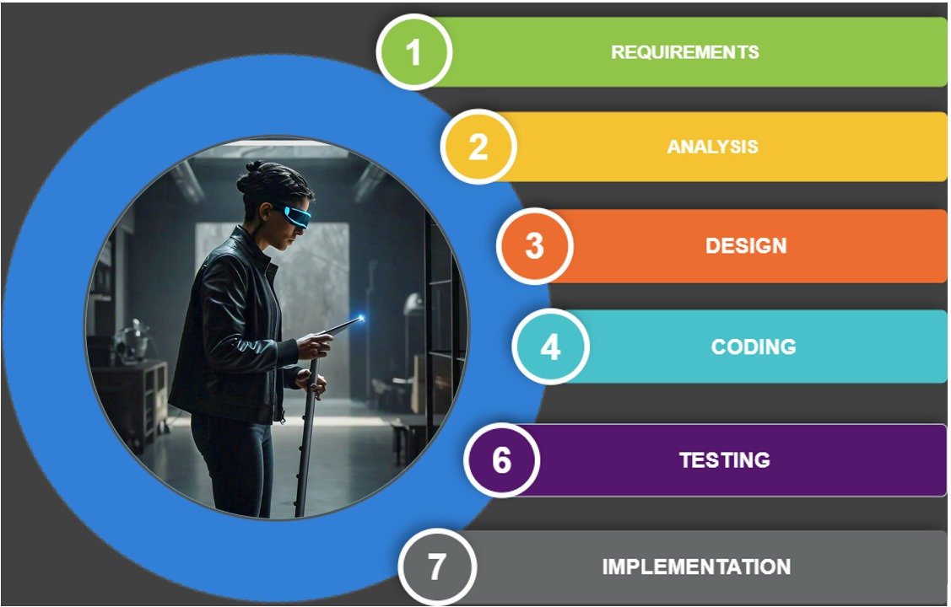
PROJECT CYCLE

Slide 24
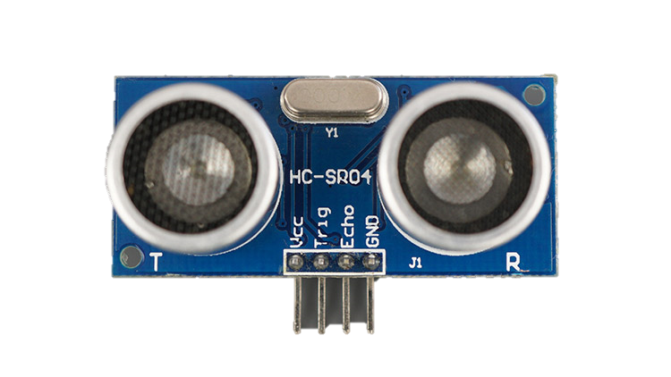
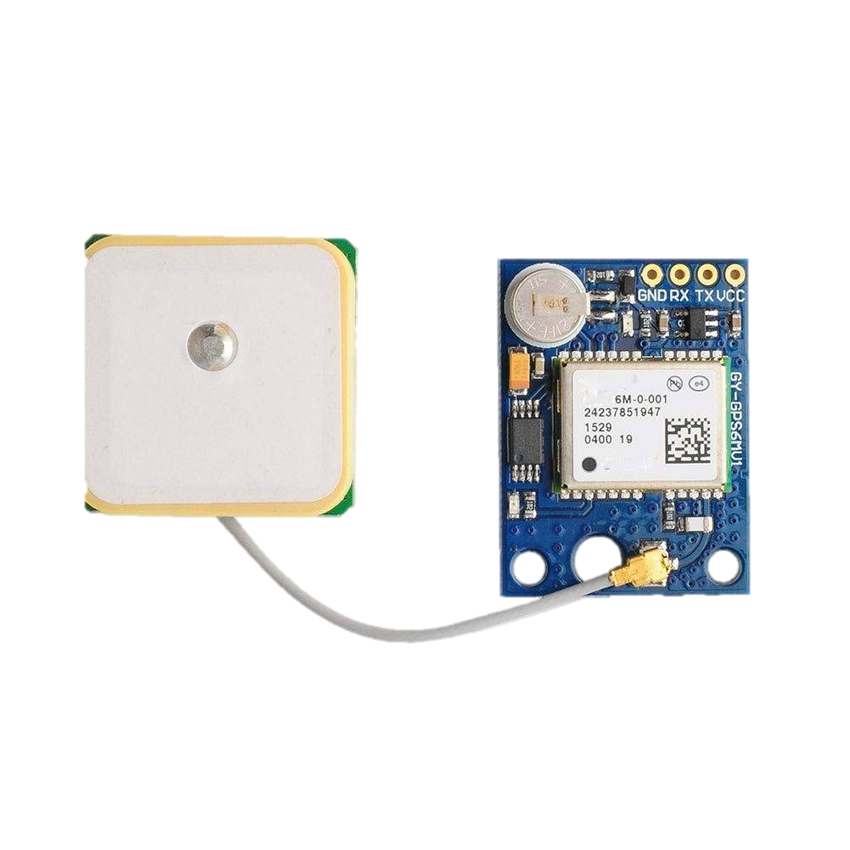
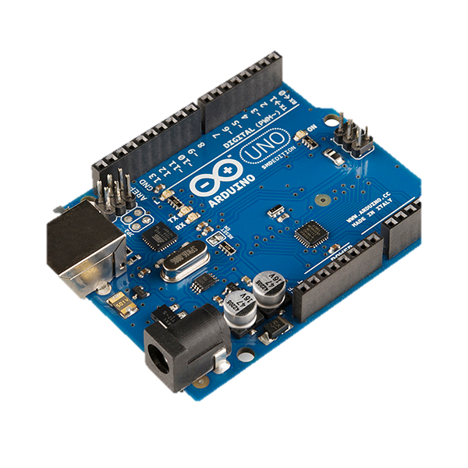
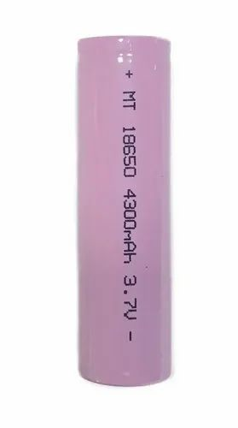
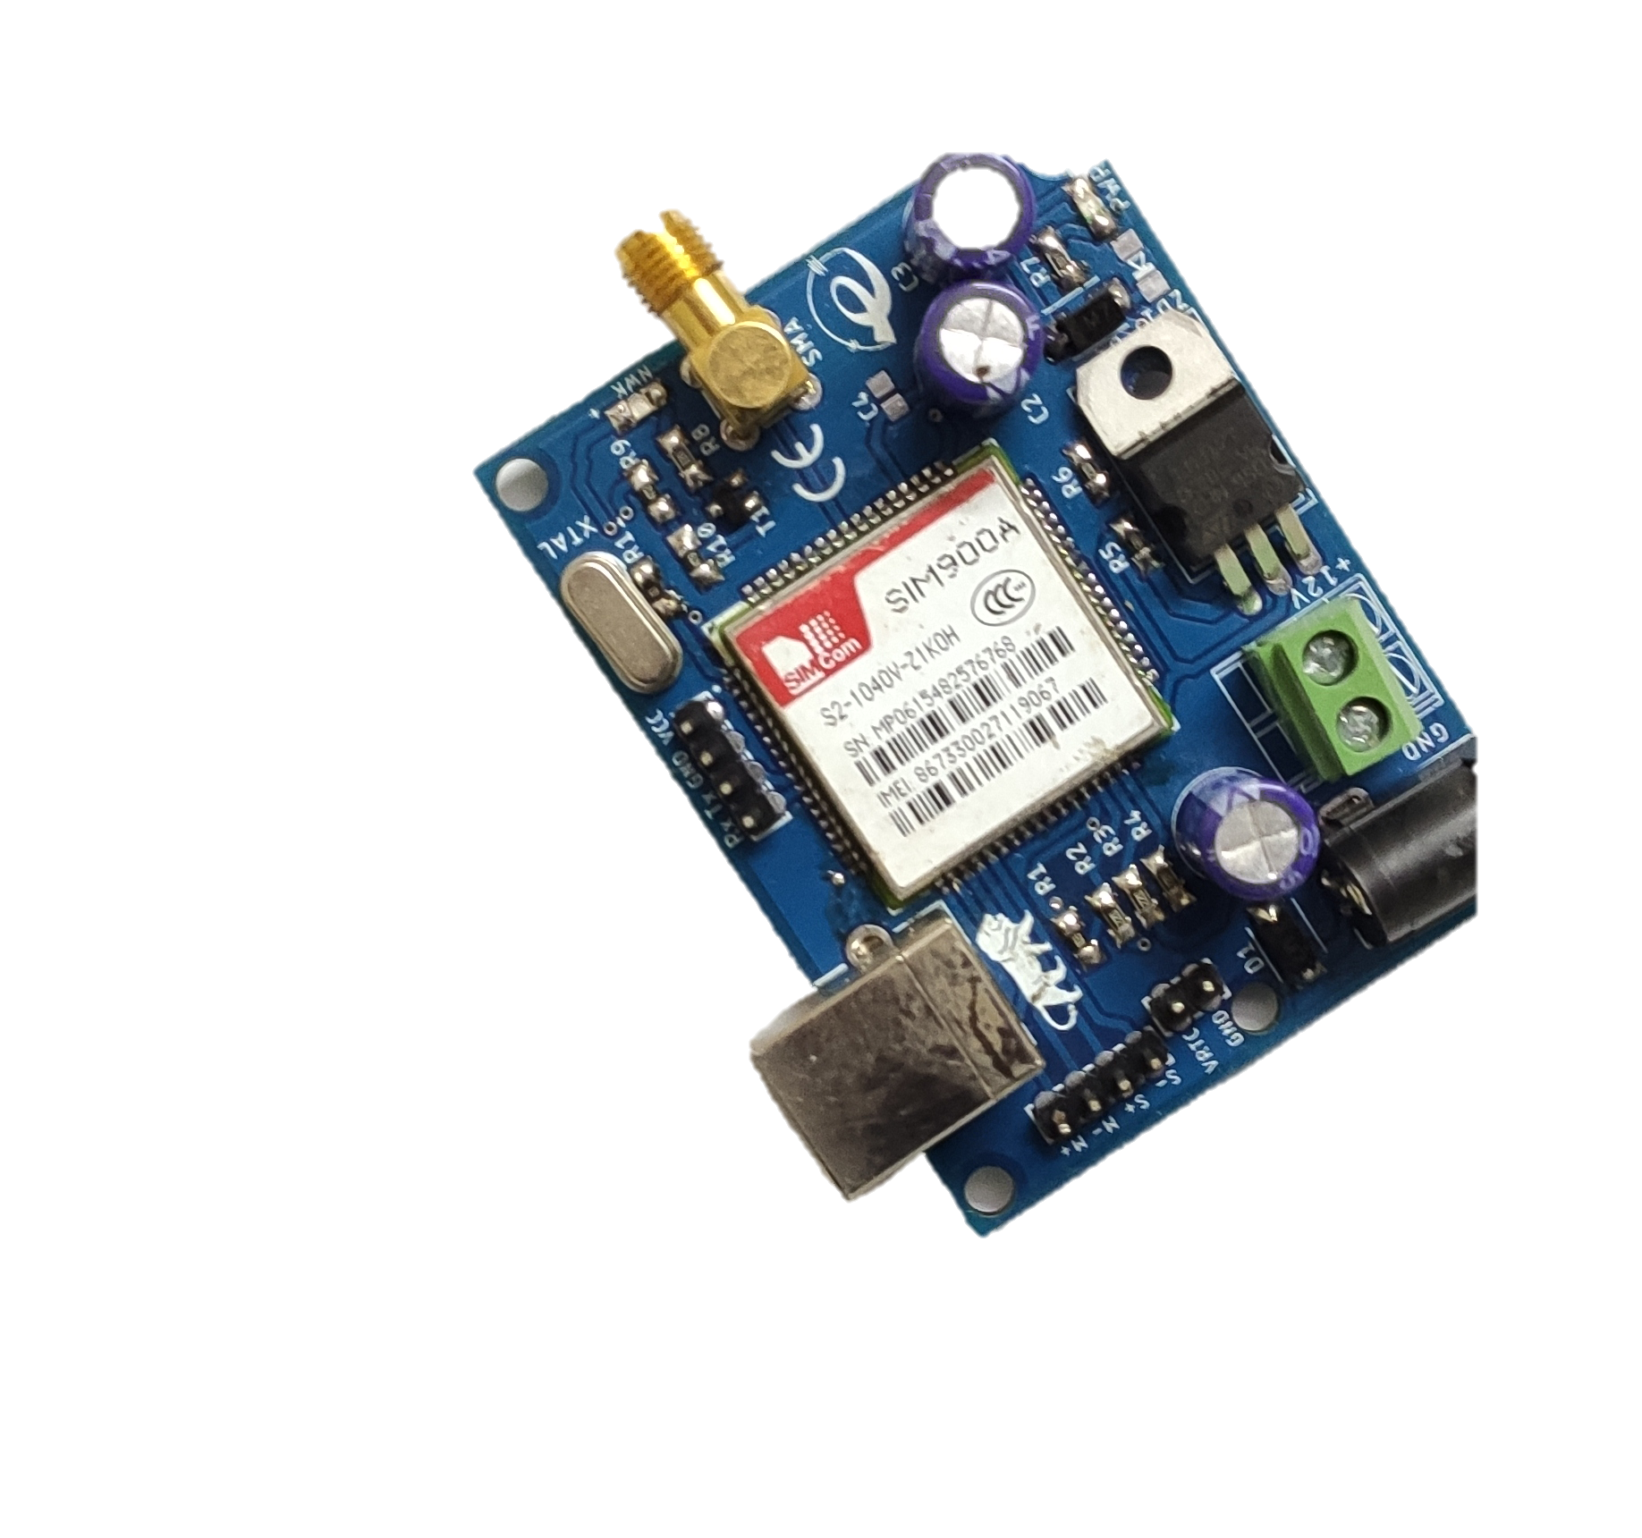

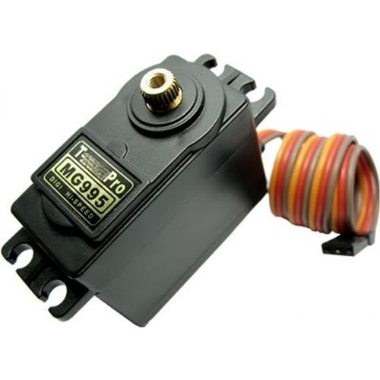
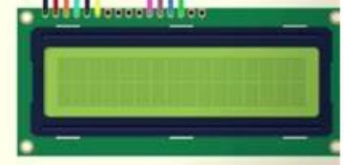
HARDWARE REQUIREMENTS
Arduino
Ultrasonic Sensor
GPS Module
Power Supply
GSM Module
Speaker
Servo Motor
LCD Module

Slide 25
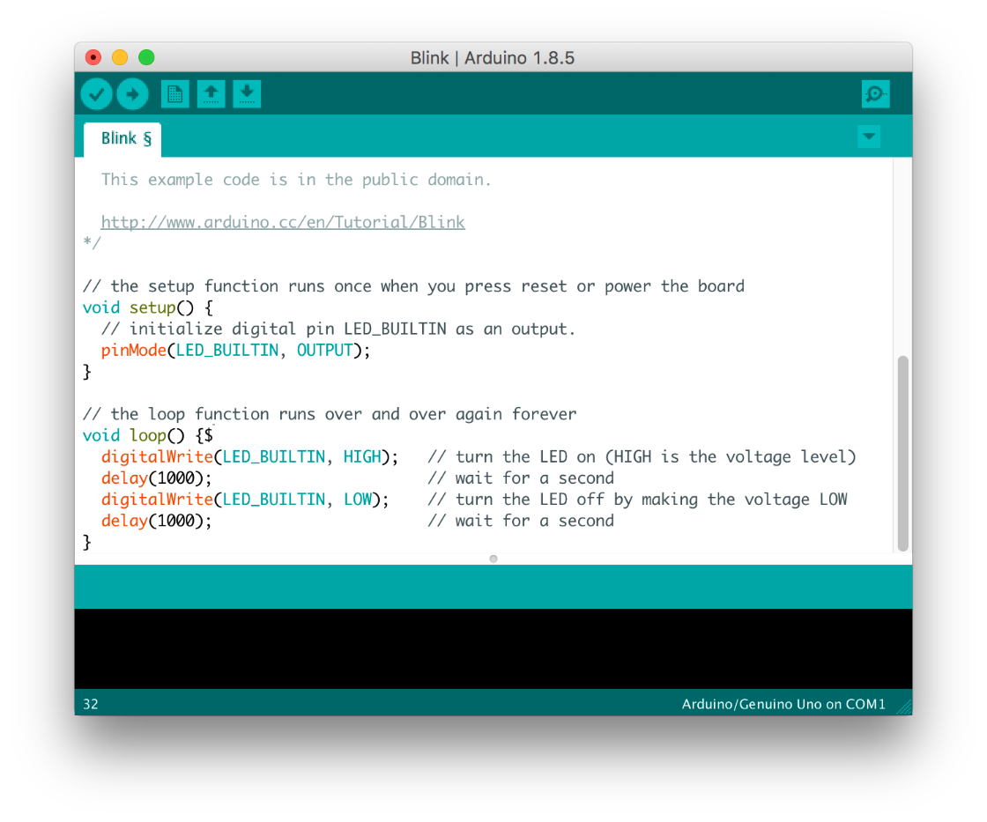

SOFTWARE REQUIREMENTS
Arduino IDE
Embedded C

Slide 26

SYSTEM DESIGN

Slide 27
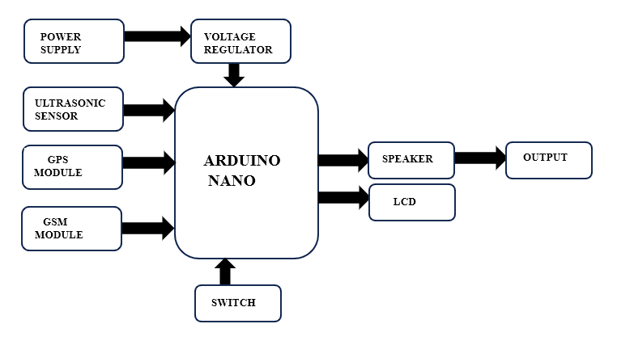
BLOCK DIAGRAM

Slide 28
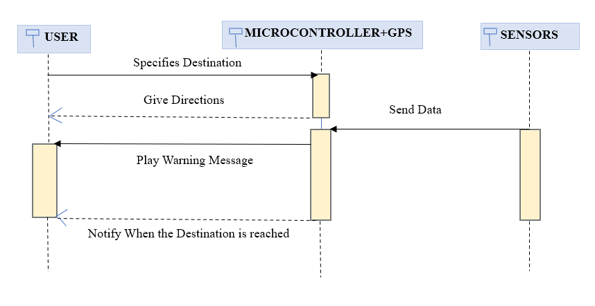
SEQUENCE DIAGRAM

Slide 29
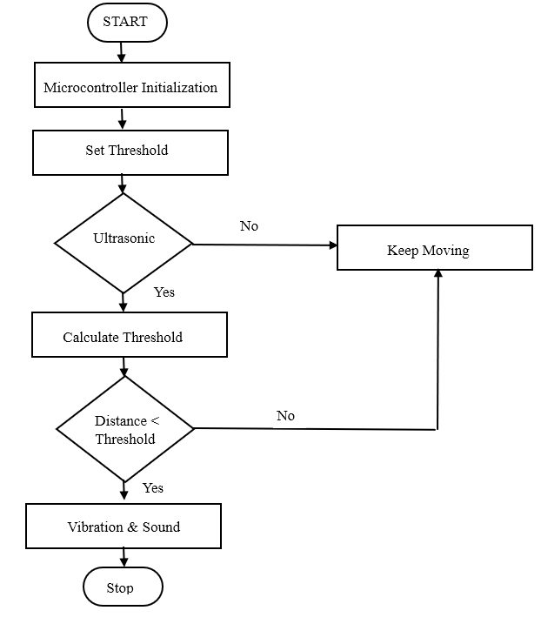
FLOW CHART

Slide 30
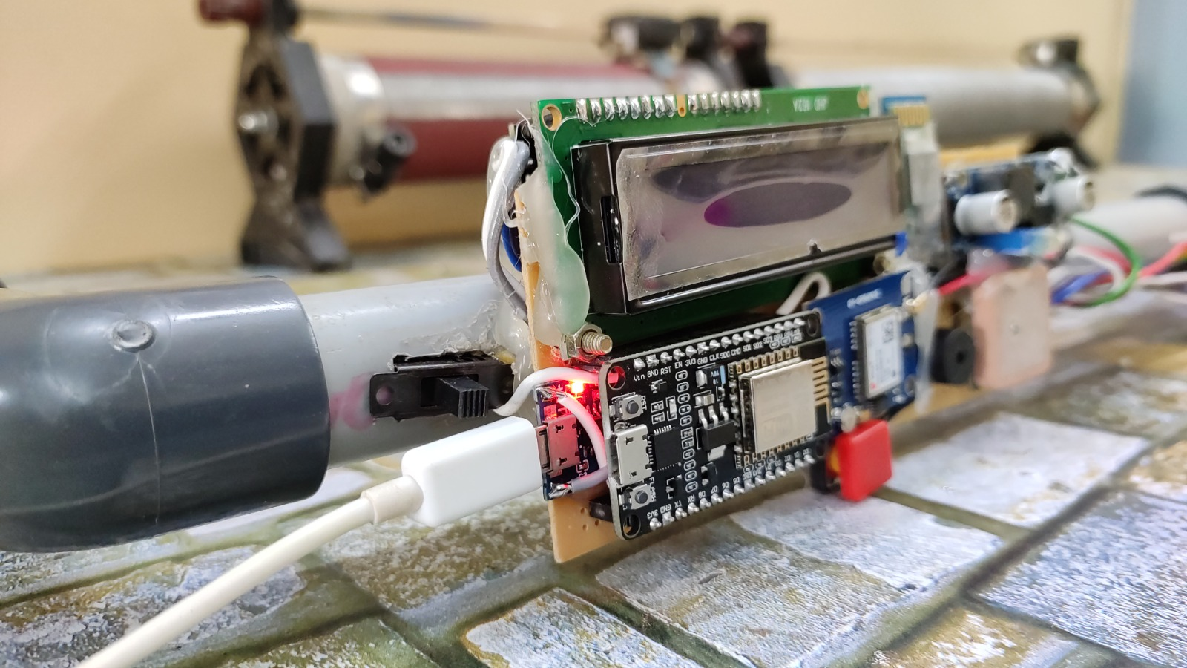
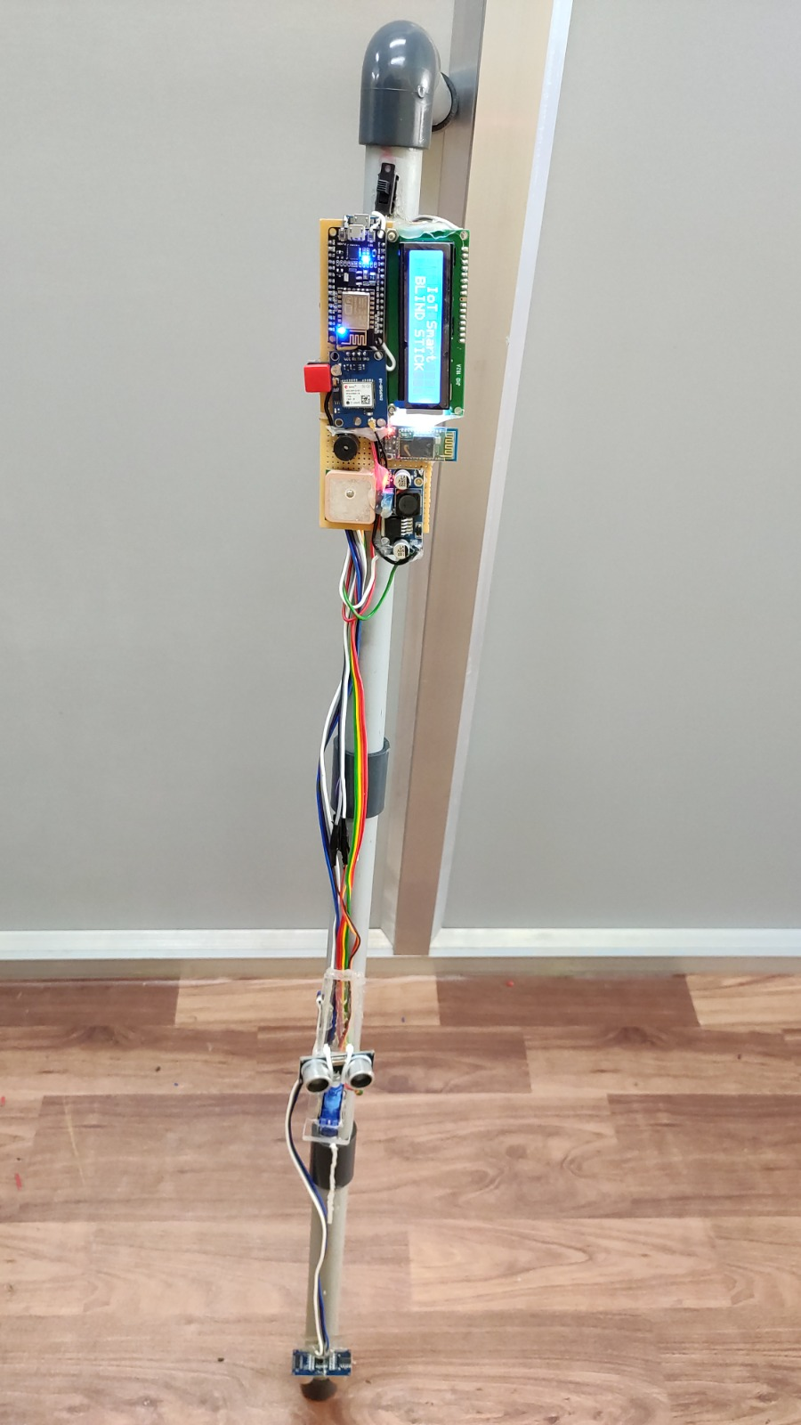
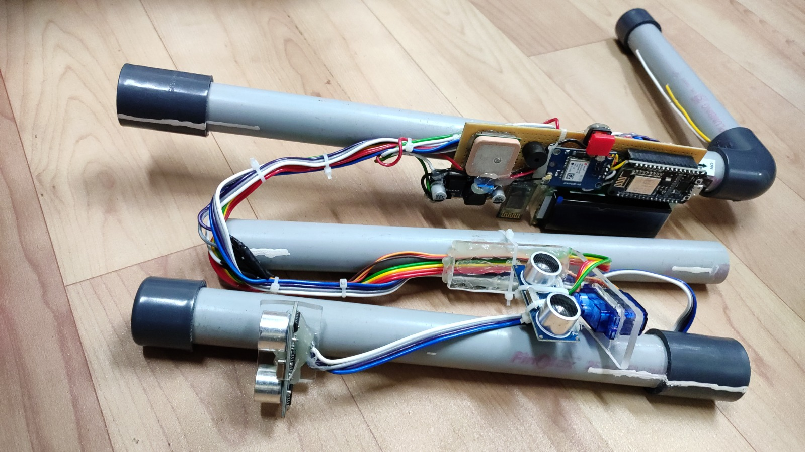
SNAPSHOTS

Slide 31

SUMMARY
It is an effective assistive technology for visually impaired individuals, enabling them to navigate both indoors and outdoors safely and independently.
The project emphasizes that this smart stick, equipped with modern sensors and technologies, offers a significant improvement over traditional white canes.

Slide 32

REFERENCES
Design and Development of Smart Blind Stick for Visually Impaired People M O A Javed et al 2024 IOP Conf. Ser.: Mater. Sci. Eng. 1305 012032
Romadhon, A. S., & Husein, A. K. (2020). Smart Stick for the Blind Using Arduino. Journal of Physics: Conference Series, 1569(3), p. 032088. doi: 10.1088/1742-6596/1569/3/032088.
World Health Organization. (2010). Action Plan for the Prevention of Avoidable Blindness and Visual Impairment, 2009-2013.
Huang, J., Mao, L. X., Liu, H. C., & Song, M. Shun. (2022). Quality Function Deployment Improvement: A Bibliometric Analysis and Literature Review. Quality & Quantity, 56(3), 1347-1366. doi: 10.1007/s11135-021-01179-7.

Slide 33


